Slide 1



Library Management System

Slide 2
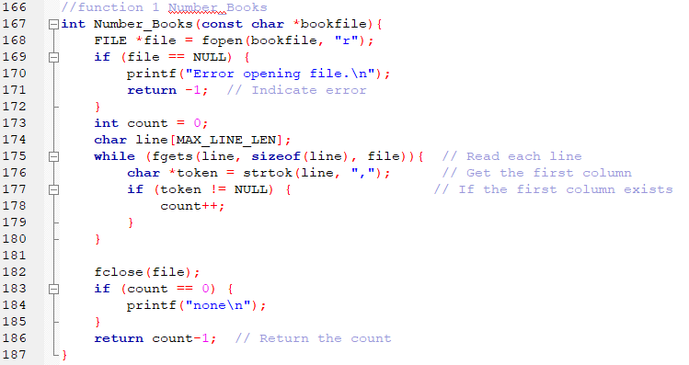
Function 1
The function counts the number of book IDs in a CSV file where the first column contains the book IDs.

Slide 3
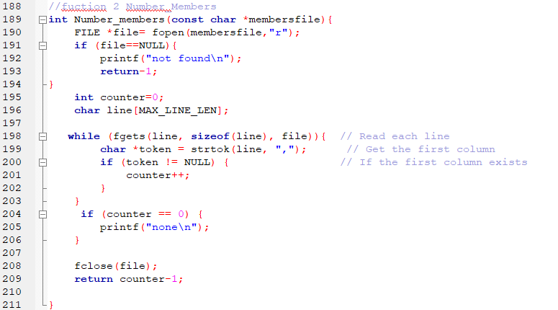
Function 2
The function counts the number of member IDs in a CSV file where the first column contains the member IDs.

Slide 4
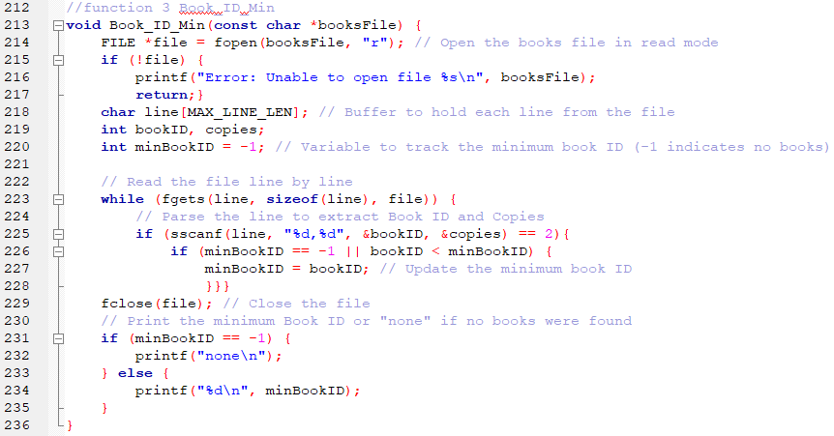
Function 3
The function identifies the minimum book ID in a CSV file where the first column contains the book IDs.

Slide 5
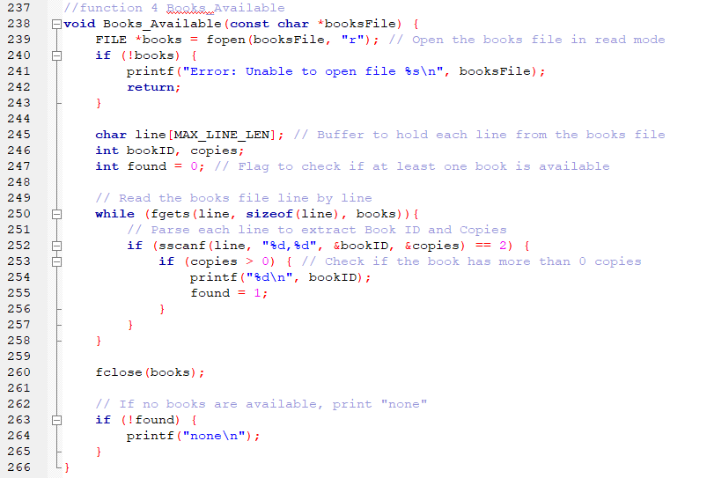
Function 4
The Books_Available function checks a file for books with available copies and prints their IDs. If no books are available, it outputs "none".

Slide 6
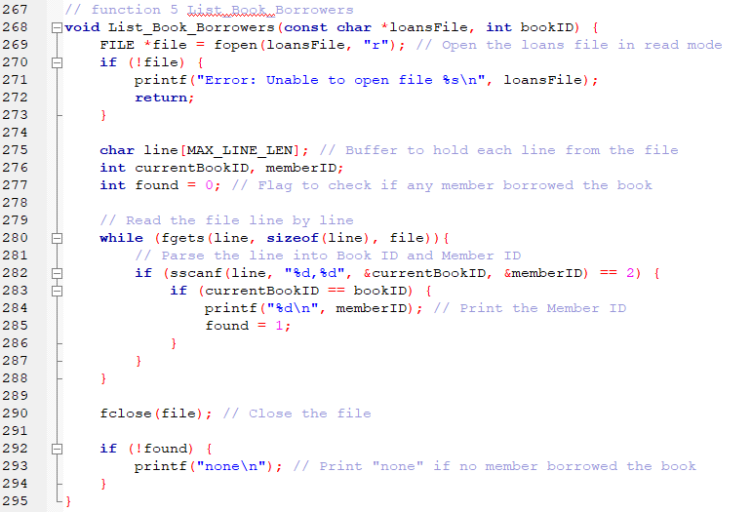
Function 5
The function lists the IDs
of members who borrowed
a specific book based on
the book ID.

Slide 7
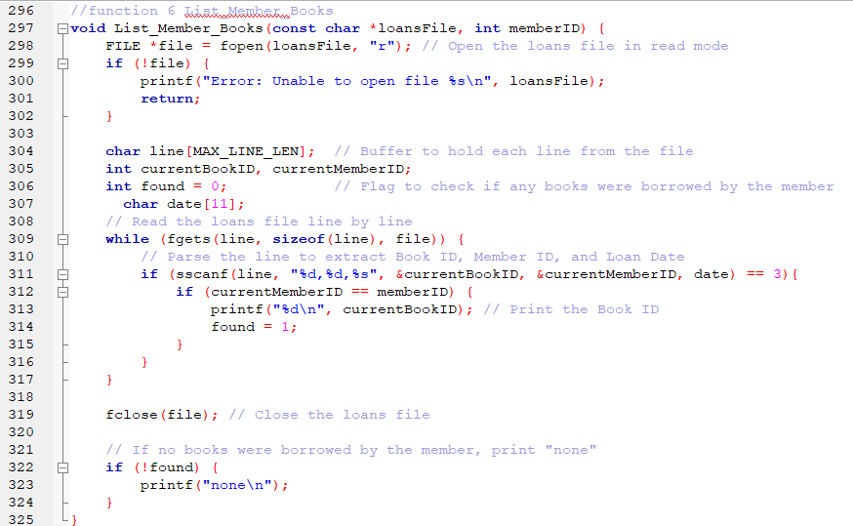
Function 6
The function is designed to list the books borrowed by a specific library member based on their ID.

Slide 8
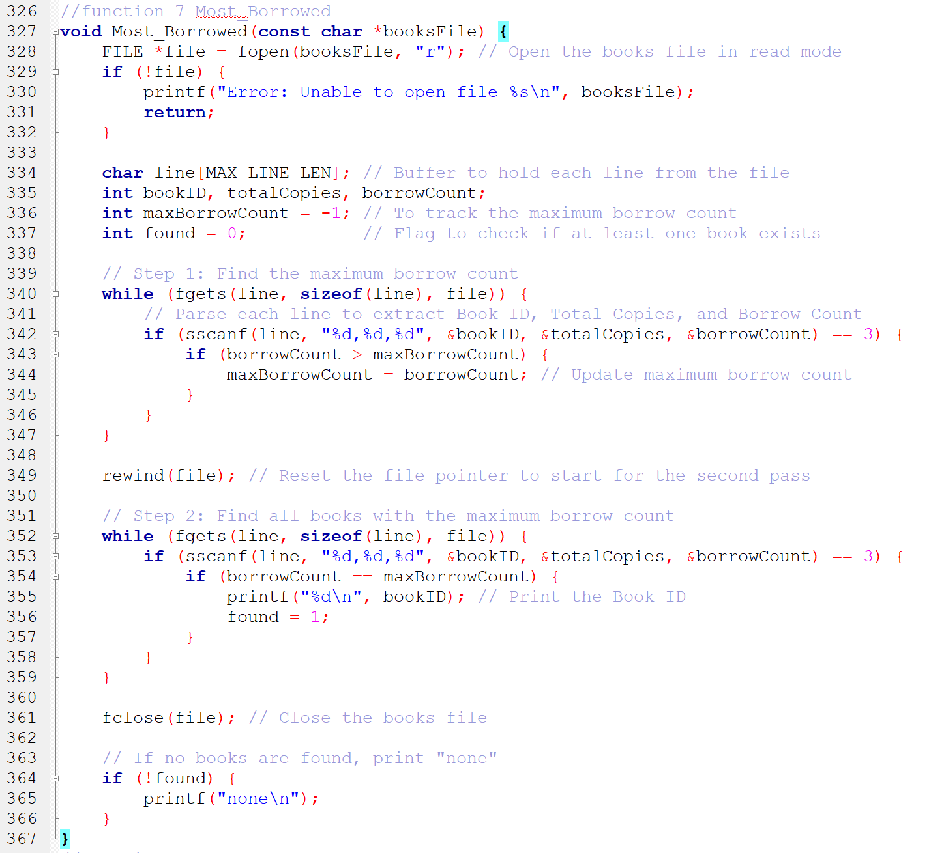
Function 7
The function identifies the book(s) with the highest borrow count in a CSV file where the columns contain book ID, total copies, and borrow count.

Slide 9
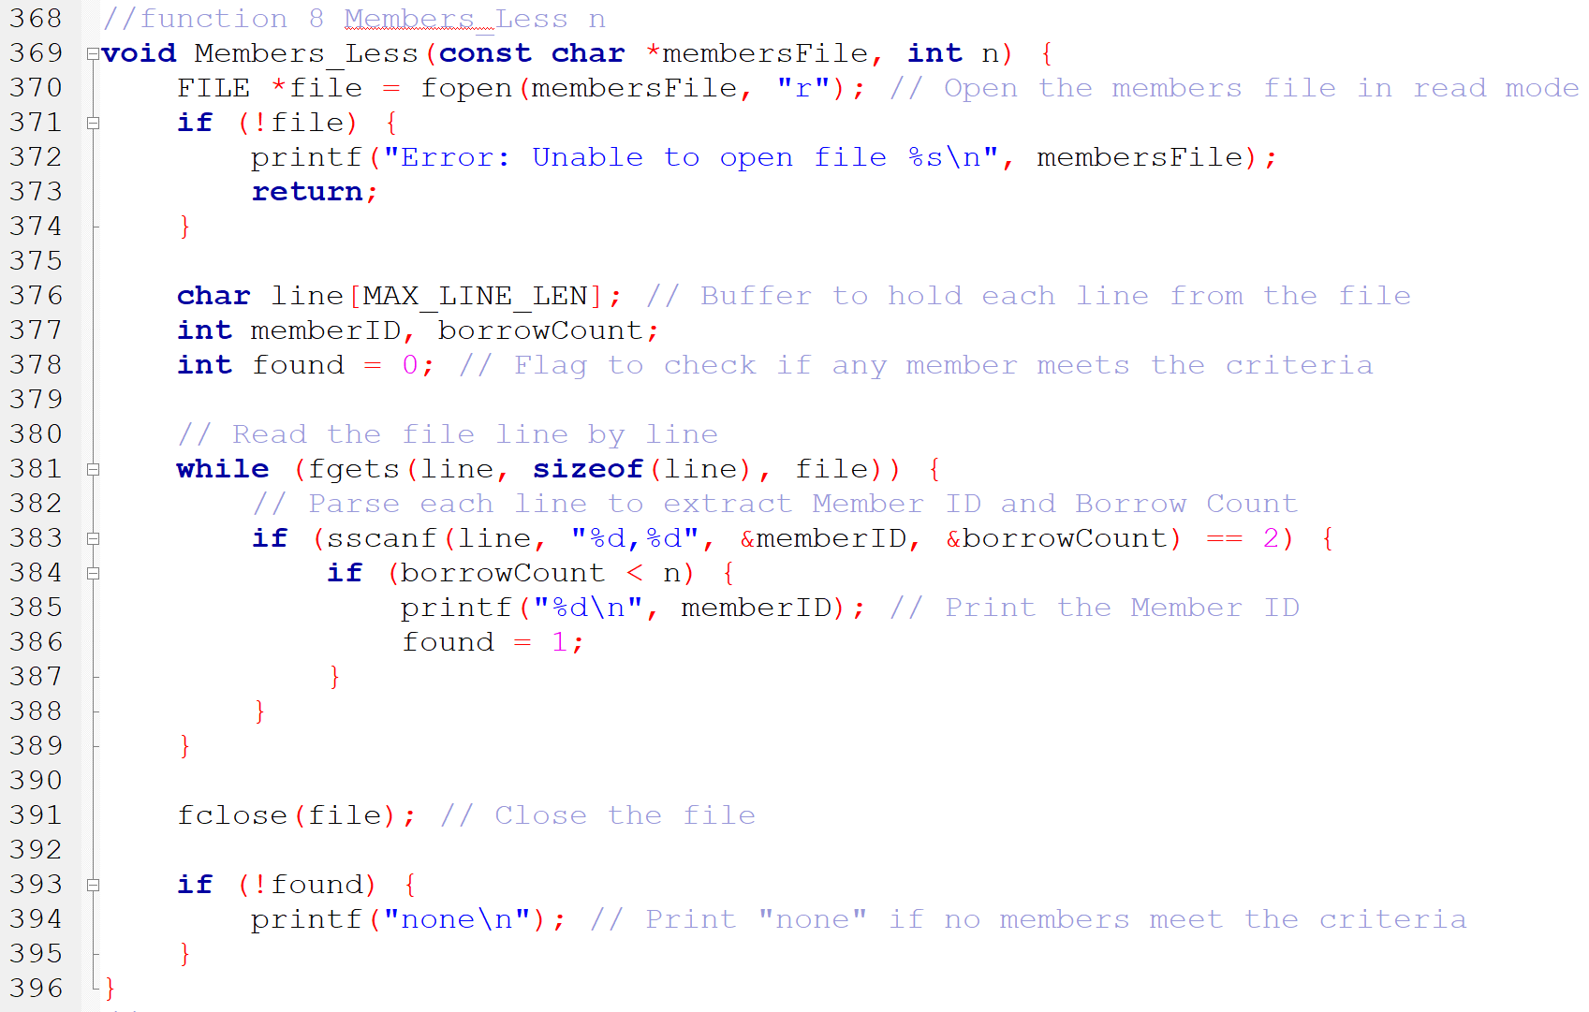
Function 8
The function is designed to list the IDs of members who have borrowed fewer books than a specified number (n)

Slide 10
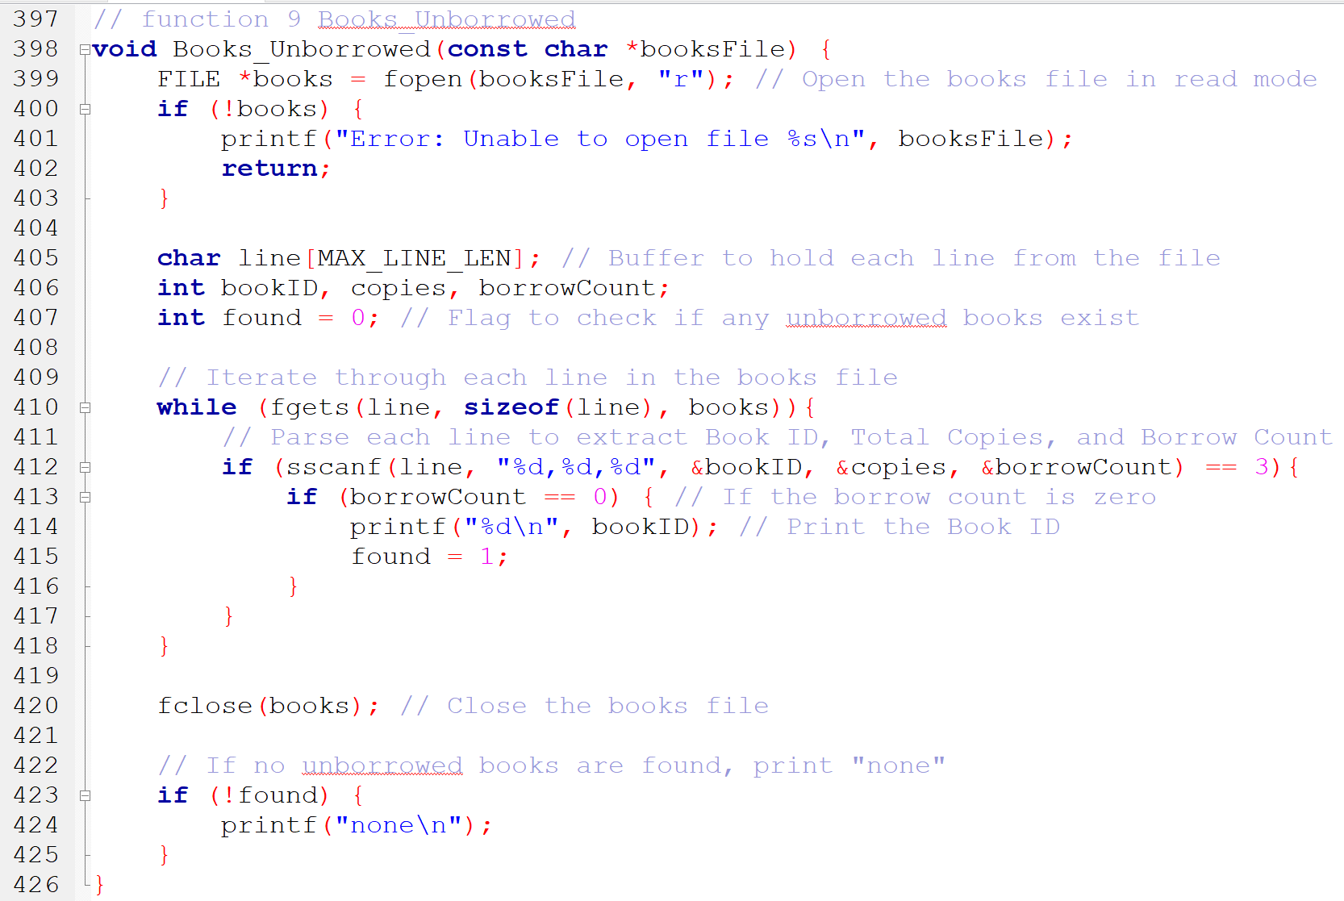
Function 9
The function identifies and lists books that have not been borrowed based on their borrow count.

Slide 11
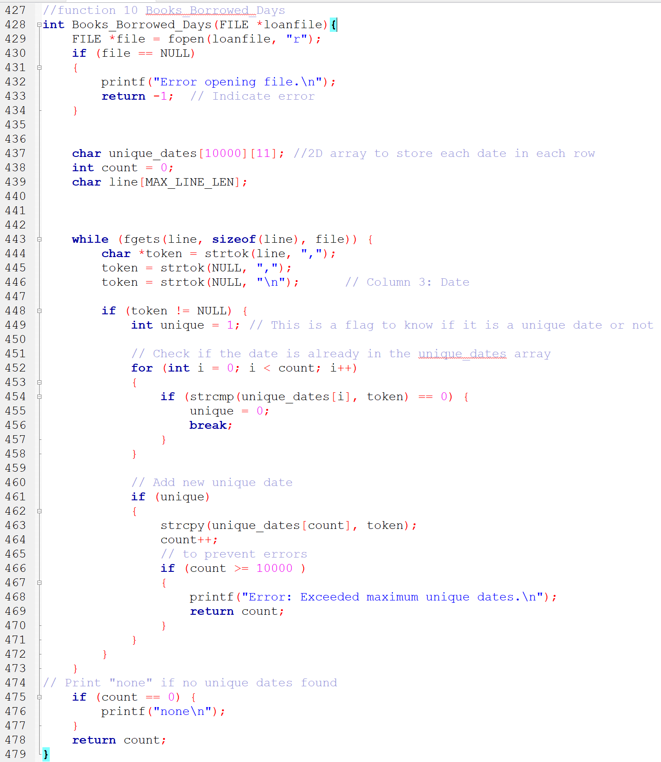
Function 10
The function calculates the total number of unique borrowing dates from a loan records CSV file. Each line contains a member ID, book ID, and borrowing date, and the function ensures that repeated dates are only counted once.

Slide 12
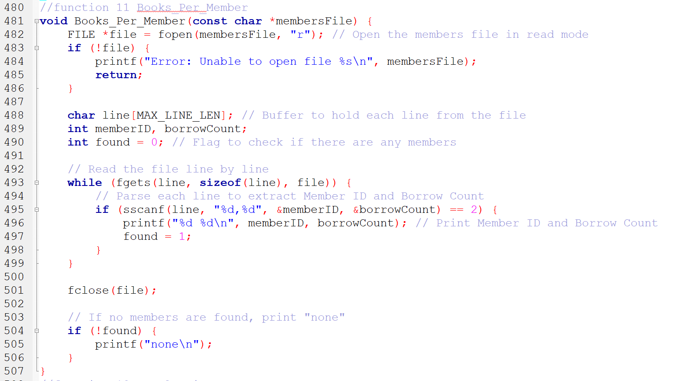
Function 11
This function reads a file containing member information and prints the IDs of members along with the number of books they have borrowed. If no data is found, it prints "none".

Slide 13
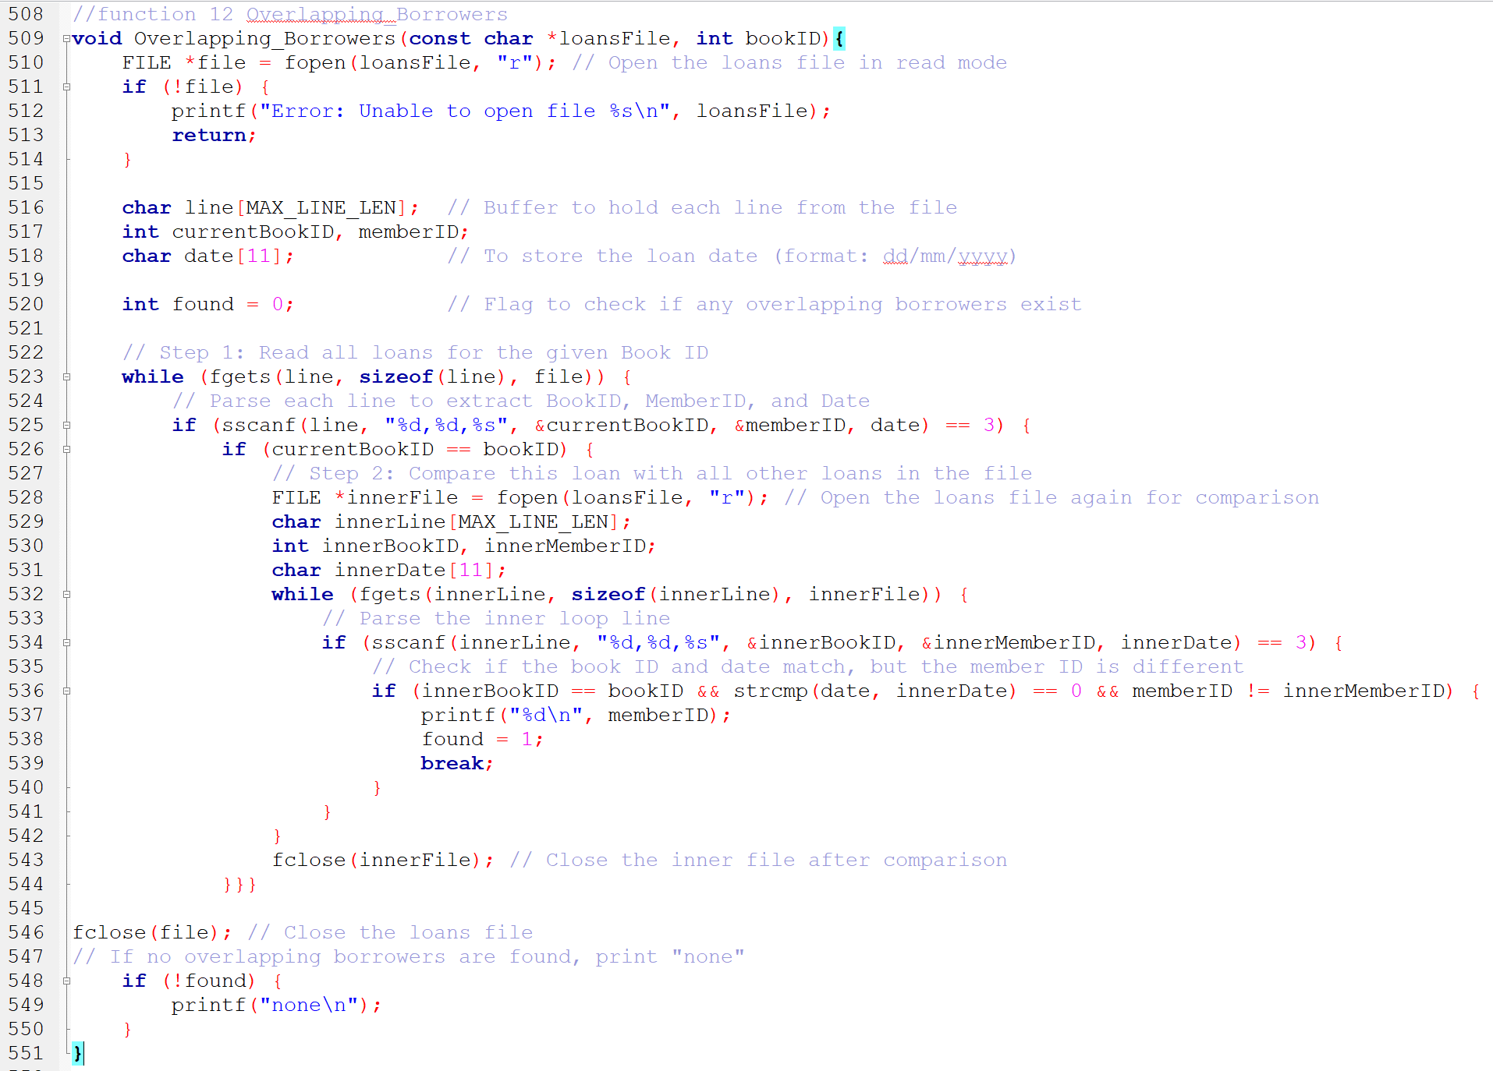
Function 12
This function identifies members who borrowed the same book on the same date as another member.

Slide 14
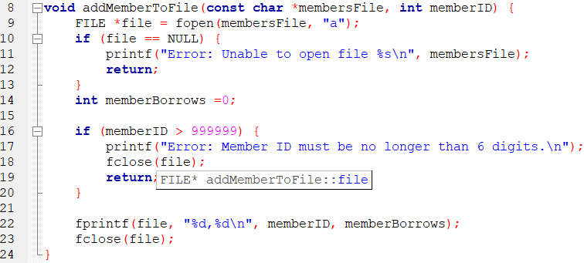
addMemberToFile function
This function adds a new member to the members file with their ID and initial borrow count.

Slide 15
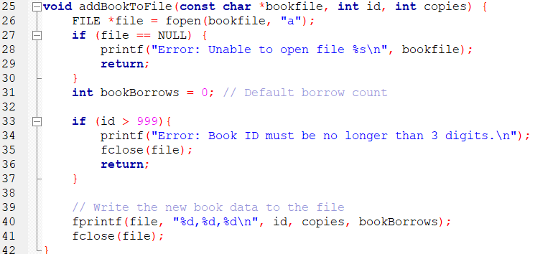
addBookToFile function
This function adds a new book to the books file with its ID, available copies, and borrow count.

Slide 16
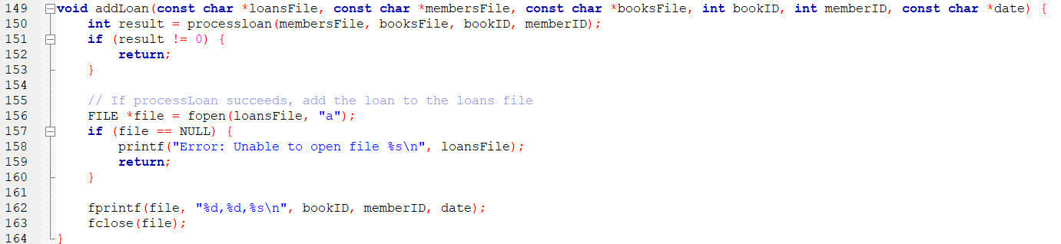
addLoan function
This function processes a loan request and adds it to the loans file. It validates the loan through the processLoan function before appending it.

Slide 17
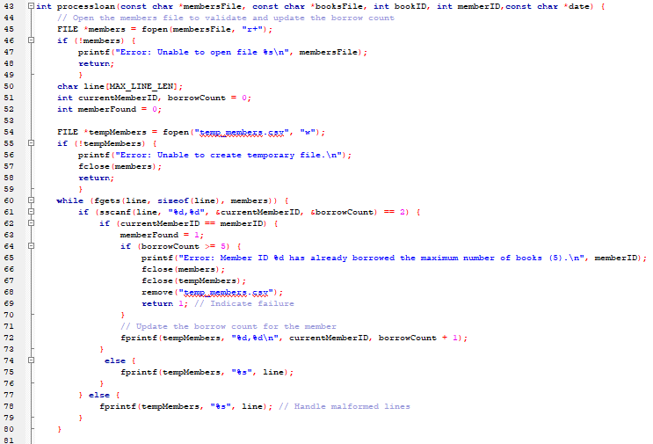
processloan function
This function validates and processes a loan request, updating the member's borrow count and the book's borrow count in their respective files.

Slide 18
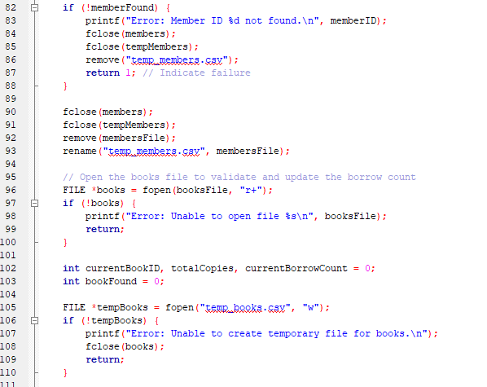

Slide 19
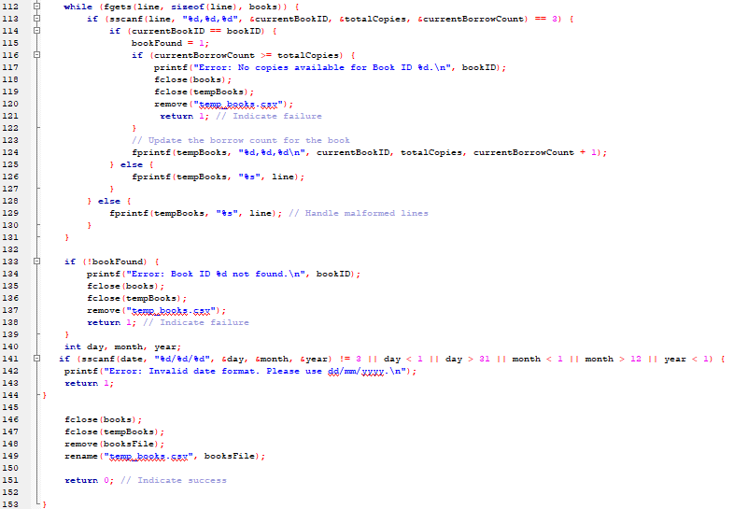

Slide 20
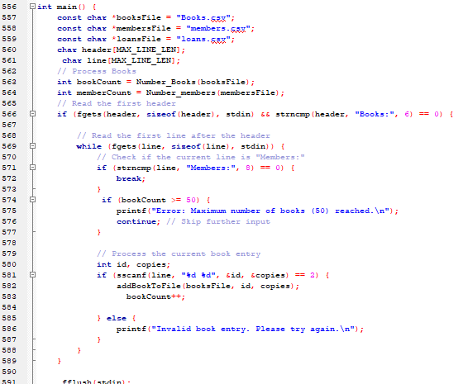
main function
This is the first part of the main function that asks the user for the input

Slide 21
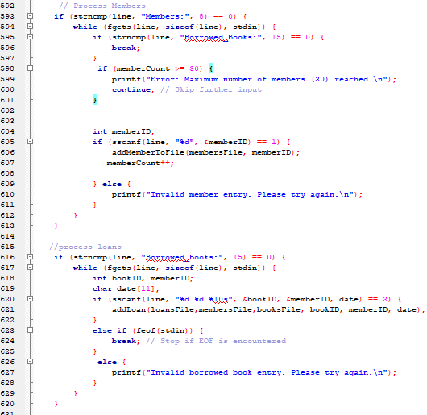

Slide 22
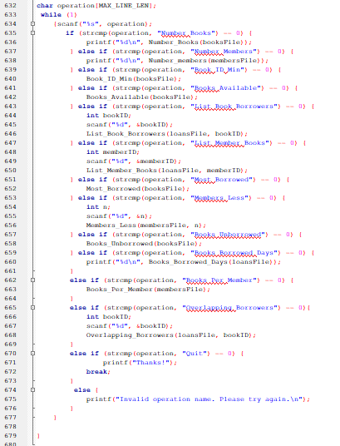
This is the second part of the main function that asks the member for operations

Slide 23
Thank You
Noureen Ibrahim mohamed hassan 22-101056
Salma Hamdy Abdel-Fattah Yassin Adam 24-101489
Mariam Ashraf Abdelrahman Ahmed 24-101500
Hams Said Hussein Mohamed 24-101485
Shahd Yasser Mohamed Elazab 24-101493
Nayera Abdeltawab Abdelghany Elnoby 24-101495

